Slide 1
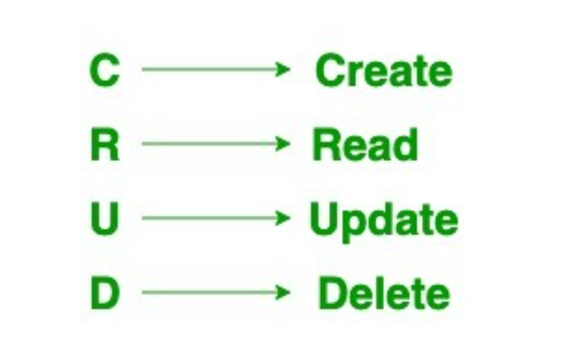

Spring Boot CRUD Application

Slide 2
Client
Controller
Service
Repository
Database
HTTP POST
HTTP GET
HTTP PUT
HTTP DELETE

Slide 3


